Slide 1
Balancing Ball Game
Yutaka Tokunaga

Slide 2
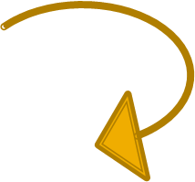
Game
You tilt the rectangle placed on the center bottom of the screen to balance a ball from either falling off the rectangle or touch the enemy.

Slide 3
Major Disaster

Slide 4
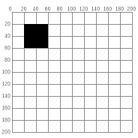
Core
Processing Grid
(x, y) grid

Slide 5
Key Classes
Main class (the class where everything works )
Entity class (the actors in the game)
- player (balanced ball)
- enemy (balls that fall from the top of the screen)
Map class (implements player and enemy)
BallPhysics class (the physics on the balancing ball)

Slide 6
What did not work
The ball physics
The ballPhysics class would not initiate upon activation
Can’t read Applet Viewer

Slide 7
What did work
The rectangle
- the rectangle rotates with the mouse
Player and enemy
- the two classes extends from the entity class

Slide 8
In detail (rectangle)
In main class used (update, mouseMoved)
update method
- updates the game
- records the last location of the mouse
- rotates the rectangle based on direction
mouseMoved method
- gets the current mouse location
- finds the direction
Math.toRadians(Math.atan2(difference of current and last Y location, difference of current and last X location divided by 2 times);
- change current location into last location

Slide 9
In detail (Entity)
Velocity
location ( created in Location class)
Radius
Collision detector

Slide 10
In detail (Ball Physics)
Confused on “how add physics on a ball”
Wanted the ball to speed up as it rolled on a direction for a extended period of time.
Needed acceleration
Needed to update the location of the ball every frame

Slide 11
Attempts (Ball Physics)
Used SystemTimeMillis to measure time of the ball
Tried to find the slope that the ball must move by using the 2 Y and 2 X values of the rectangle on left and right
Tried to apply acceleration on the ball by using derivative

Slide 12
If I had more time
Ask for help
Search information online
Try different methods

